Slide 1
Week 7
Notes

Slide 2
Gradient Descent
Gradient Descent is an optimization algorithm used to minimize a function by adjusting its parameters.
Commonly used in machine learning for optimizing cost functions.
It iteratively adjusts the parameters to reduce the error.

Slide 3
Why Gradient Descent?
Helps in finding the minimum of complex cost functions.
Crucial for training machine learning models such as neural networks, linear regression, etc.
Enables large-scale data processing and parameter tuning efficiently.

Slide 4
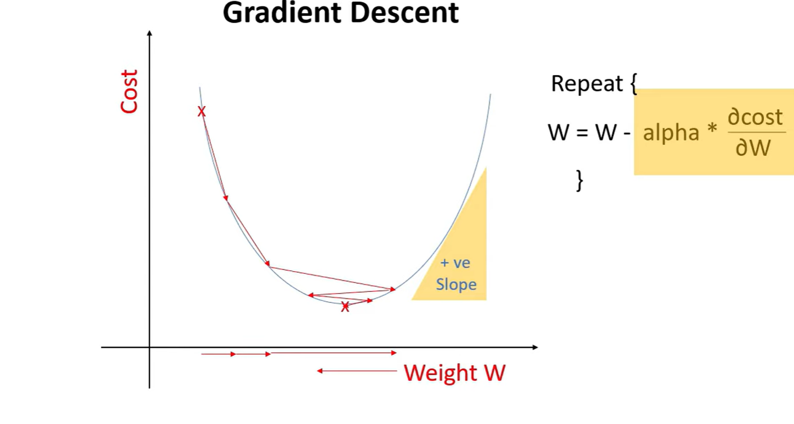
Gradient Descent Algo to minimize the cost (Loss)
Notes:
🧠 What does $\frac{d\left(\text{cost}\right)}{d\left(\text{weight}\right)}$mean?
It means:
👉 “How much does the cost change if I slightly change the weight?”
The cost function = how wrong your model is
The weight = a knob you can adjust
Now ask:
👉 If I turn this knob (weight) a tiny bit, what happens to the error (cost)?
Gradient Descent plays a central role in Machine Learning because it is the main method used to train models—that is, to help them learn from data by minimizing error.
Gradient descent works by iteratively adjusting the weight $W$to minimize the cost function based on the slope $\frac{∂\text{cost}}{∂W}$. In the graph, when the weight is on the left side of the curve, the slope is negative, meaning the cost decreases as $W$increases, so the update rule increases the weight and moves it to the right toward the minimum. As it approaches the bottom, the slope becomes smaller, resulting in smaller adjustments. At the minimum point, the slope is zero, so the weight stops changing. If the weight moves to the right side of the curve, the slope becomes positive, meaning the cost increases as $W$increases, so the update rule decreases the weight and moves it back to the left. Thus, depending on whether the slope is negative or positive, gradient descent moves the weight in the opposite direction of the slope until it converges at the point where the slope is zero.

Slide 5
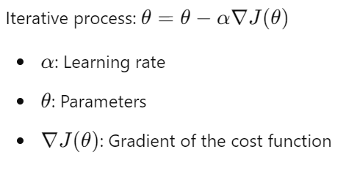
Concept of Gradient Descent
The gradient is a vector of partial derivatives representing the slope of the function.
Gradient Descent works by taking steps proportional to the negative of the gradient.

Slide 6
Understanding the Cost Function
Measures the error between predicted and actual values.Objective:
Minimize the cost function.
Common cost functions:
Mean Squared Error (MSE) for regression.
Cross-Entropy for classification.

Slide 7
Gradient Descent Process
Initialize the parameters randomly.
Compute the gradient of the cost function.
Update parameters using the gradient and learning rate.
Repeat until convergence.

Slide 8
Types of Gradient Descent
Stochastic Gradient Descent With Momentum
Mini Batch Gradient Descent
Adagrad (Adaptive Gradient Descent)
RMS Prop (Root Mean Square)
AdaDelta
Adam Optimizer

Slide 9
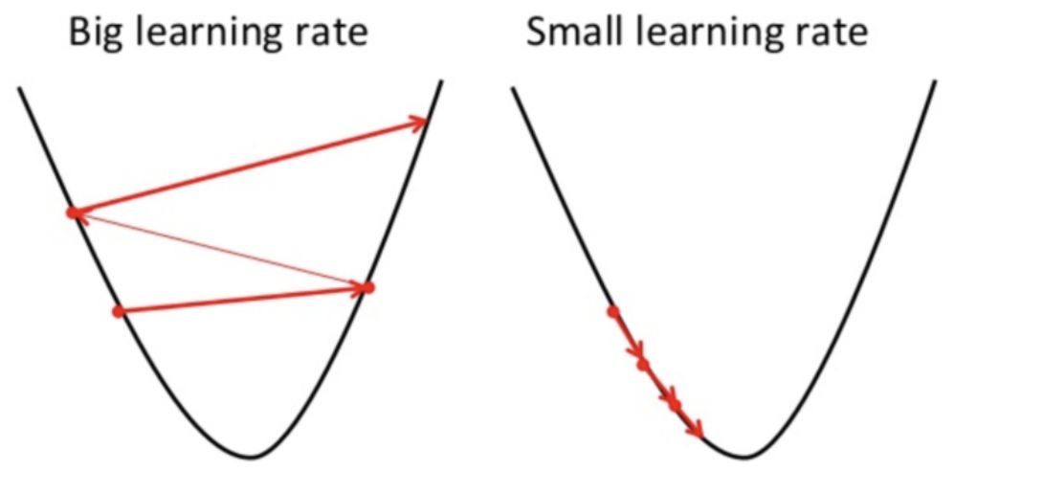
Gradient Descent Learning Rate
Controls the step size at each iteration. Too high: Risk of overshooting the minimum. Too low: Slow convergence. Best practice: Experiment with different learning rates or use learning rate scheduling.

Slide 10
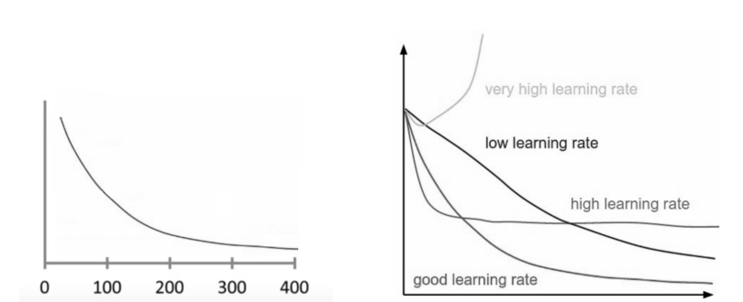
How to Solve Gradient Descent Challenges

Slide 11
Neural Network
The hyperparameters to tune are:
the number of neurons,
activation function,
optimizer,
learning rate,
batch size,
epochs.

Slide 12
Neural Network
the process to tune 2 things of Neural Network:
(1) the hyperparameters and
(2) the layers.
Notes:
Tuning a neural network involves improving its performance by adjusting (1) hyperparameters and (2) the network architecture (layers).
These two are related but optimized differently.
Tuning a neural network involves optimizing both its hyperparameters and its architecture (layers) to achieve the best performance. Hyperparameters are the settings defined before training, such as learning rate, batch size, number of epochs, optimizer, and regularization techniques. The tuning process typically begins with a baseline model using standard values, followed by systematic adjustment of key parameters—starting with the learning rate, as it has the most significant impact on performance. Techniques such as manual tuning, grid search, or random search can be used to explore different combinations. Model performance is evaluated using a validation set, and parameters are iteratively refined based on metrics like accuracy and loss, while also monitoring for overfitting or underfitting.
At the same time, tuning the layers involves designing the structure of the neural network, including the number of hidden layers, the number of neurons in each layer, and the types of layers used. The process usually starts with a simple architecture and gradually increases complexity by adding more layers or neurons if the model is underfitting. Conversely, if the model overfits, the architecture may be simplified or regularization techniques such as dropout may be introduced. The choice of layer types (e.g., dense, convolutional, or recurrent) depends on the nature of the data and problem. In practice, tuning is an iterative process where the architecture and hyperparameters are adjusted together—layers define the model’s capacity to learn, while hyperparameters control how effectively it learns.

Slide 13
first hyperparameter to tune: number of neurons in each hidden layer
the number of neurons in every layer is set to be the same.
It also can be made different.
The number of neurons should be adjusted to the solution complexity.
The task with a more complex level to predict needs more neurons.
The number of neurons range is set to be from 10 to 100.

Slide 14
An activation function
There are 9 activation functions to tune:
'relu', 'sigmoid', 'softplus', 'softsign', 'tanh', 'selu', 'elu', 'exponential', LeakyReLU, 'relu’
Each activation function has its own formula (and graph) to compute the input values

Slide 15
optimizer
The layers of a neural network are compiled and an optimizer is assigned.
The optimizer is responsible to change the learning rate and weights of neurons in the neural network to reach the minimum loss function.
Optimizer is very important to achieve the possible highest accuracy or minimum loss.
There are 8 optimizers to choose from. Each has a different concept behind it.
SGD', 'Adam', 'RMSprop', 'Adadelta', 'Adagrad', 'Adamax', 'Nadam', 'Ftrl'

Slide 16
learning rate
One of the hyperparameters in the optimizer is the learning rate.
We will also tune the learning rate.
Learning rate controls the step size for a model to reach the minimum loss function. A higher learning rate makes the model learn faster, but it may miss the minimum loss function and only reach the surrounding of it.
A lower learning rate gives a better chance to find a minimum loss function. As a tradeoff lower learning rate needs higher epochs, or more time and memory capacity resources.

Slide 17
Batch size
If the observation size of the training dataset is too large, it will definitely take a longer time to build the model.
To make the model learn faster, we can assign batch size so that not all of the training data are given to the model at the same time.
Batch size is the number of training data sub-samples for the input.
If the training dataset has 77,500 observations and the batch size is 1000, the model will learn 77 times with 1000 training data sub-samples and another last learning from the 500 training data sub-samples.

Slide 18
Batch size
The smaller batch size makes the learning process faster, but the variance of the validation dataset accuracy is higher.
A bigger batch size has a slower learning process, but the validation dataset accuracy has a lower variance.

Slide 19
epoch
The number of times a whole dataset is passed through the neural network model is called an epoch.
One epoch means that the training dataset is passed forward and backward through the neural network once.
A too-small number of epochs results in underfitting because the neural network has not learned much enough.
The training dataset needs to pass multiple times or multiple epochs are required.
On the other hand, too many epochs will lead to overfitting where the model can predict the data very well, but cannot predict new unseen data well enough.
The number of epoch must be tuned to gain the optimal result. This demonstration searches for a suitable number of epochs between 20 to 100.

Slide 20
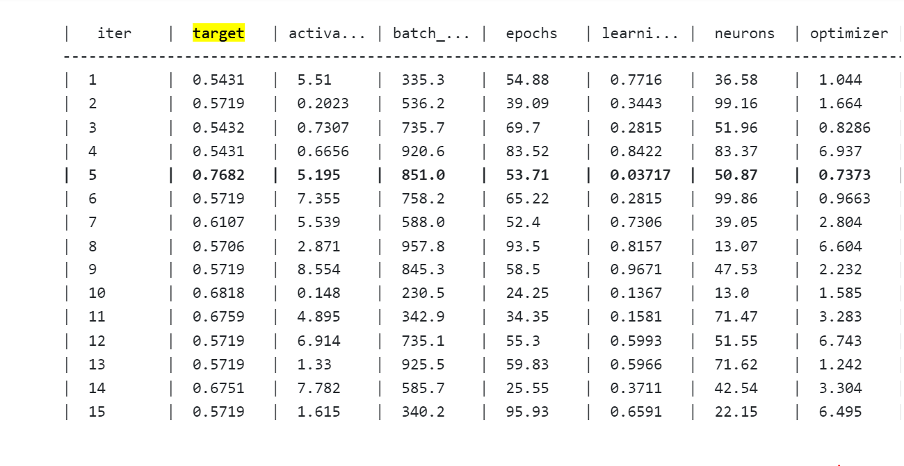

Slide 21
Tune the Layers
Layers in Neural Network also determine the result of the prediction model.
A smaller number of layers is enough for a simpler problem, but a larger number of layers is needed to build a model for a more complicated problem.

Slide 22
